Slide 1
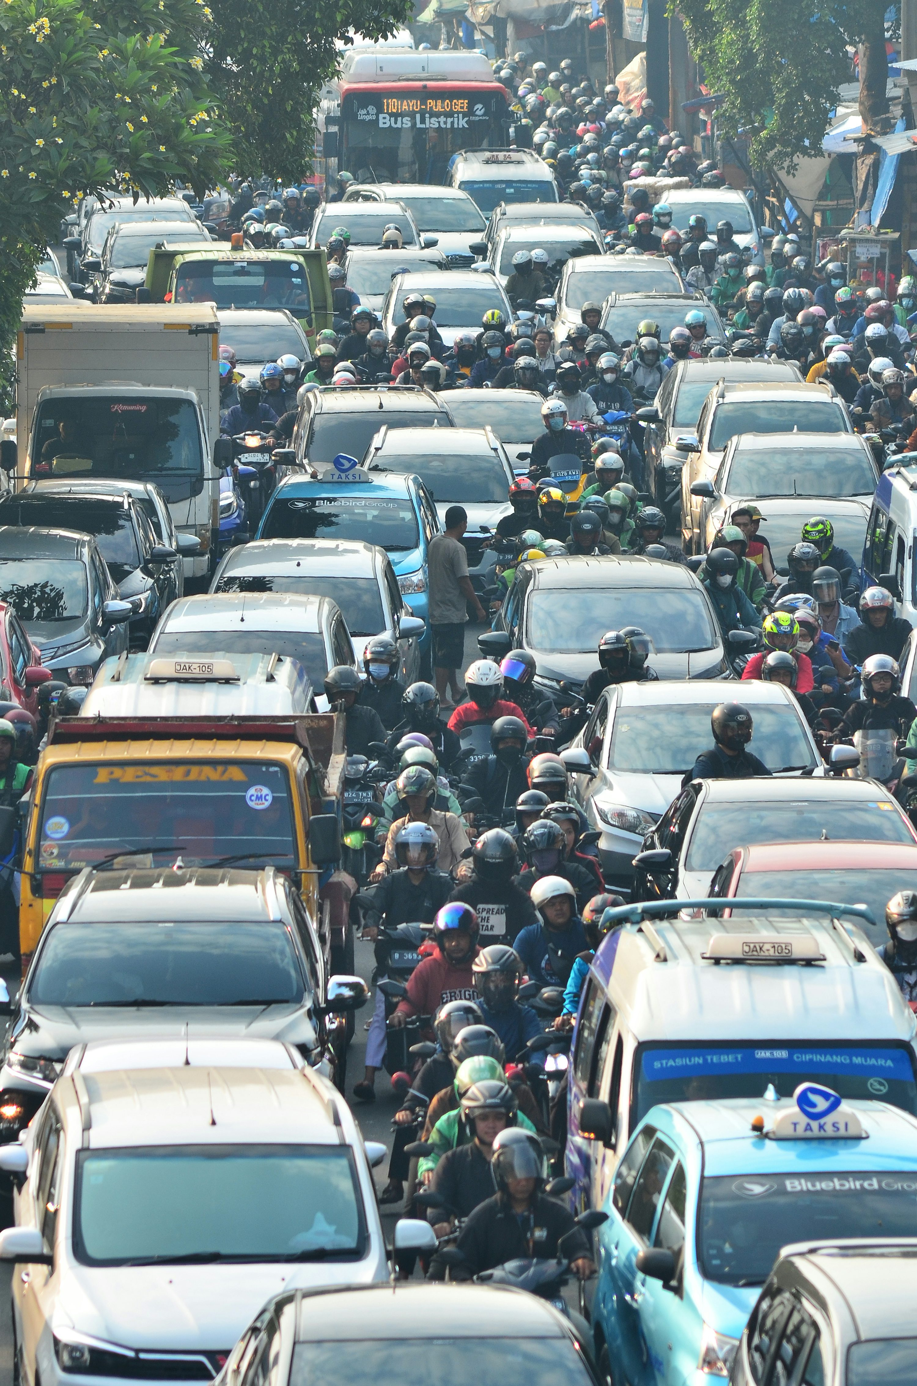
MACHINE LEARNING PROJECT
Traffic Congestion Level Prediction Using Random Forest and Gradient-Boosted Trees
TEAM MEMBERS
B. Himavanth Sai Ganesh — 2520030429
G. Shashank — 2520030495
MACHINE LEARNING
TEAM PROJECT

Slide 2

Introduction
Traffic congestion is a common urban transportation problem.
Traffic conditions change based on vehicle count, speed, time, weather and road conditions.
Machine Learning can identify patterns in historical traffic data.
The project predicts congestion levels as Low, Moderate or High.
02

Slide 3
Problem Statement
Traffic congestion changes continuously.
Traditional approaches may not accurately capture complex relationships between traffic and environmental factors.
A Machine Learning system is required to analyse traffic-related features and predict congestion severity.
MAIN GOAL
To predict traffic congestion levels using Machine Learning.
03

Slide 4
Objectives
01
02
03
Collect and prepare traffic data.
Clean and preprocess the dataset.
Analyse traffic patterns.
04
05
06
Build Random Forest and Gradient-Boosted Trees models.
Predict Low, Moderate and High congestion.
Evaluate model performance.
04

Slide 5
Dataset Overview
Traffic-related dataset
Vehicle count
Average speed
Time / day
Weather
Road / junction characteristics
Target variable: Congestion Level
PROBLEM TYPE
Supervised Learning
Classification
TARGET CLASSES
Low
Moderate
High
05

Slide 6
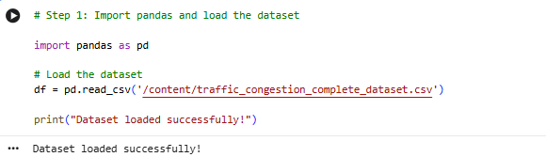
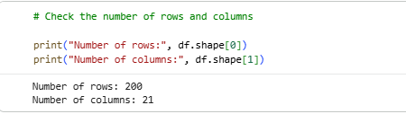
Load Dataset
The dataset is loaded into the working environment using Python.
The data is inspected to review its structure and initial records.
[INSERT CODE SCREENSHOT — DATASET LOADING CODE]
Dataset Loading and Initial Inspection
06

Slide 7
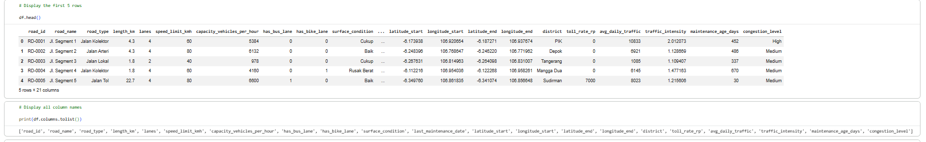
Data Understanding / Preprocessing
Understand dataset structure.
Check data types.
Identify missing values.
Clean and transform the data.
Prepare data for Machine Learning.
[INSERT CODE SCREENSHOT — DATA PREPROCESSING]
07

Slide 8
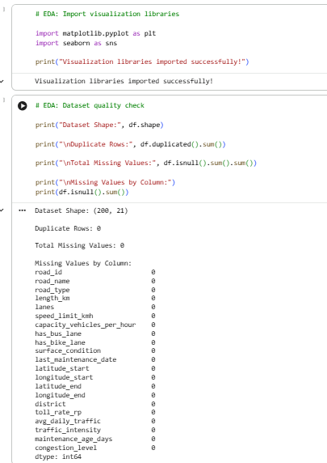
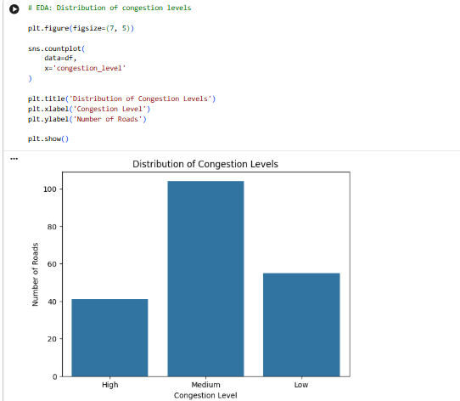
Exploratory Data Analysis (EDA)
EDA is used to understand traffic patterns.
Analyse relationships between traffic variables.
Study congestion-level distribution.
Examine vehicle count, speed, time, weather and road-related factors.
08

Slide 9
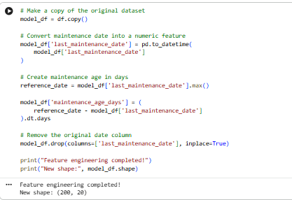
Feature Engineering
Create useful features from available traffic data.
Capture temporal and spatial traffic patterns.
Prepare relevant features for model training.
09

Slide 10
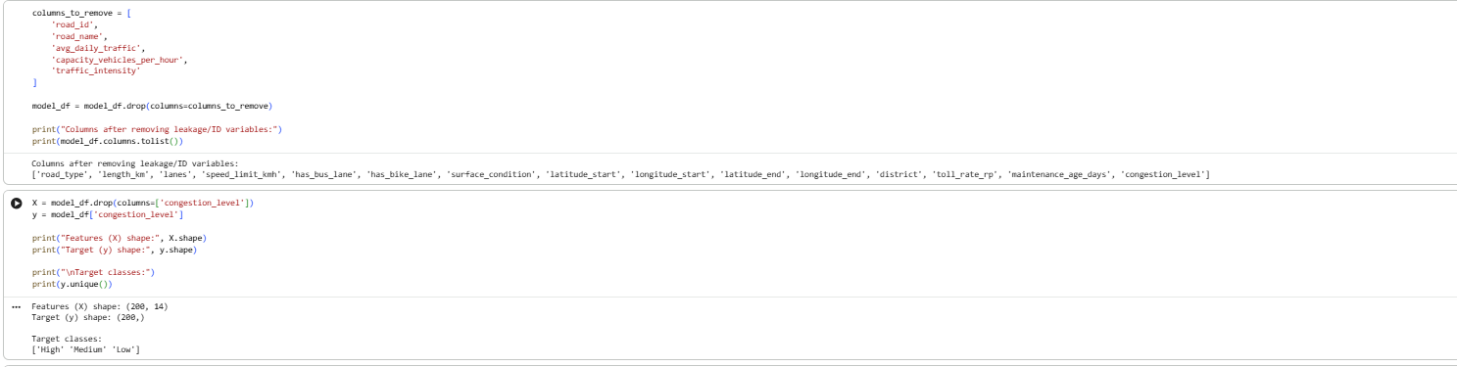
Feature Selection
Separate input features from the target variable.
Select traffic and environmental attributes as inputs.
Congestion Level is used as the target.
[INSERT CODE SCREENSHOT — FEATURE SELECTION]
10

Slide 11
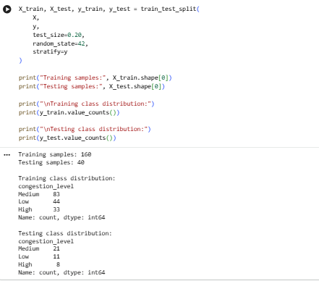
Train-Test Split
Divide the prepared dataset into training and testing data.
Training data is used to build the model.
Testing data is used to evaluate the model.
11

Slide 12
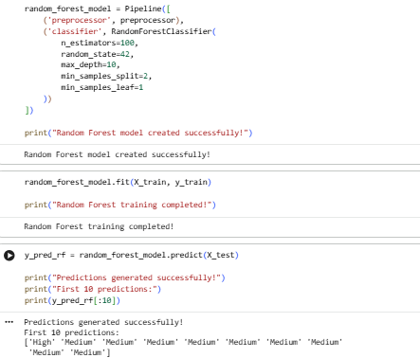
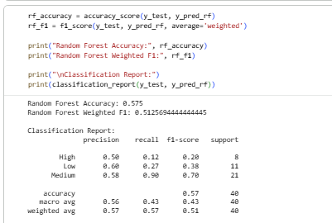
Random Forest
Random Forest is an ensemble Machine Learning algorithm.
It combines multiple decision trees.
Multiple trees work together to produce a robust prediction.
It is used to classify congestion levels.
12

Slide 13
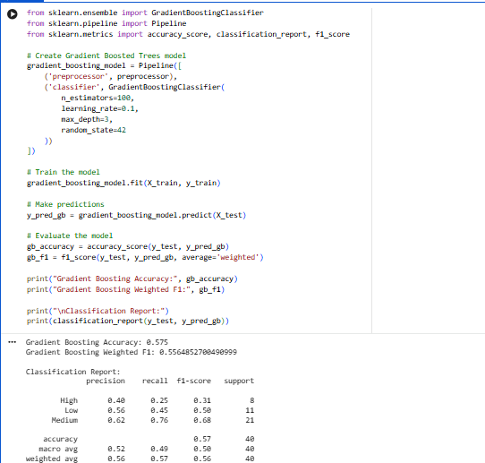
Gradient-Boosted Trees
Gradient-Boosted Trees build trees sequentially.
Each new tree learns from previous errors.
It can capture complex and non-linear traffic patterns.
It is used for congestion prediction.
13

Slide 14
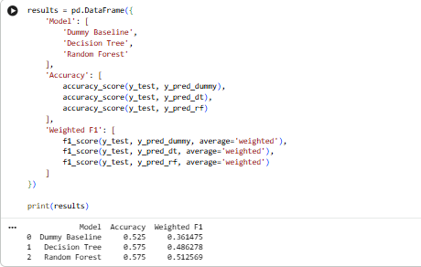
Model Evaluation
Evaluation metrics used:
Accuracy
Precision
Recall
F1-score
ROC-AUC*
*if present in the actual code
14

Slide 15
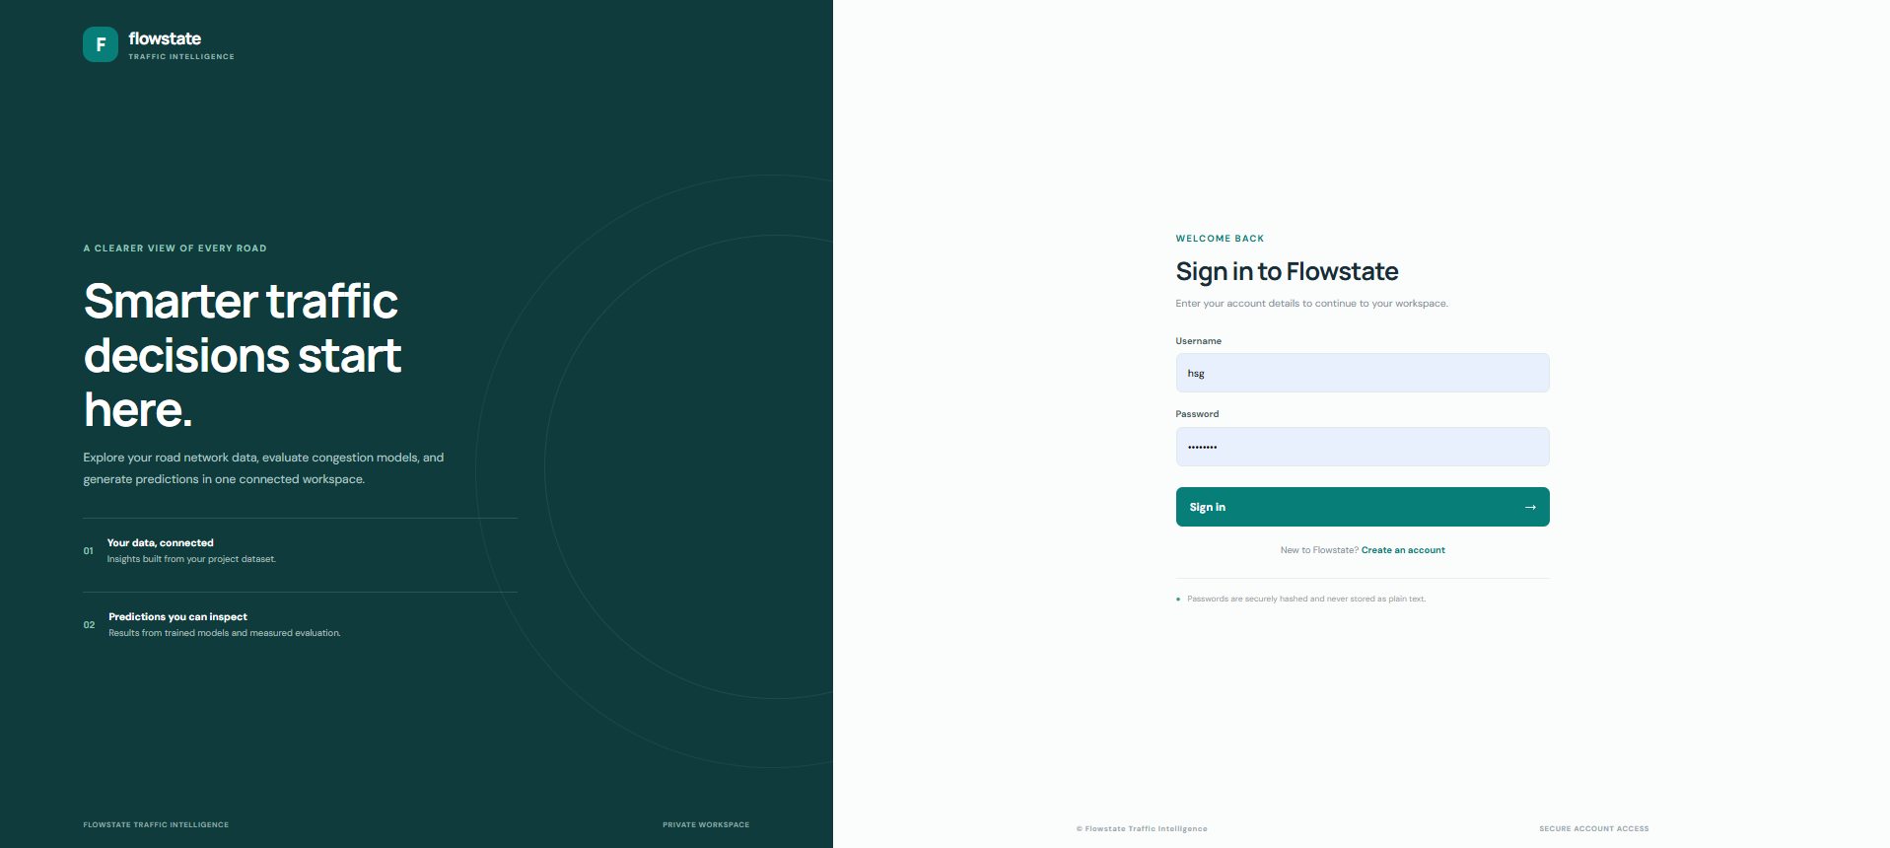
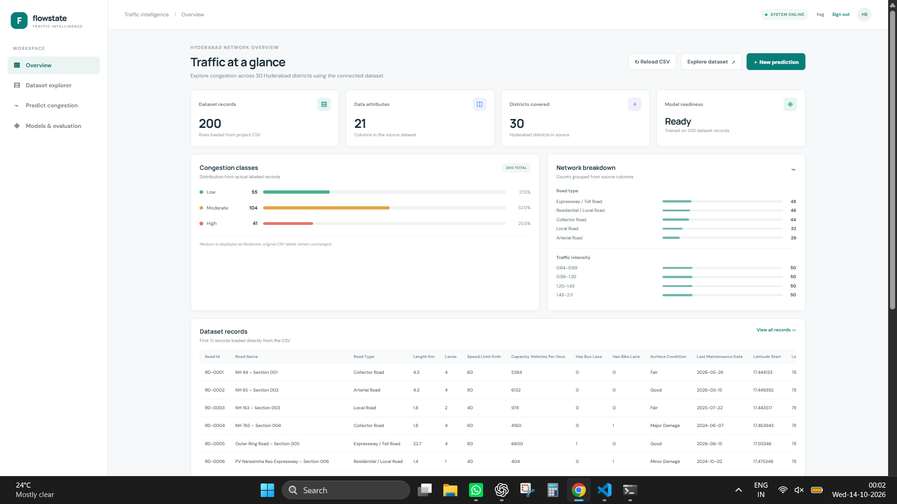
OUTPUT
IMG - 1
IMG - 2
15

Slide 16
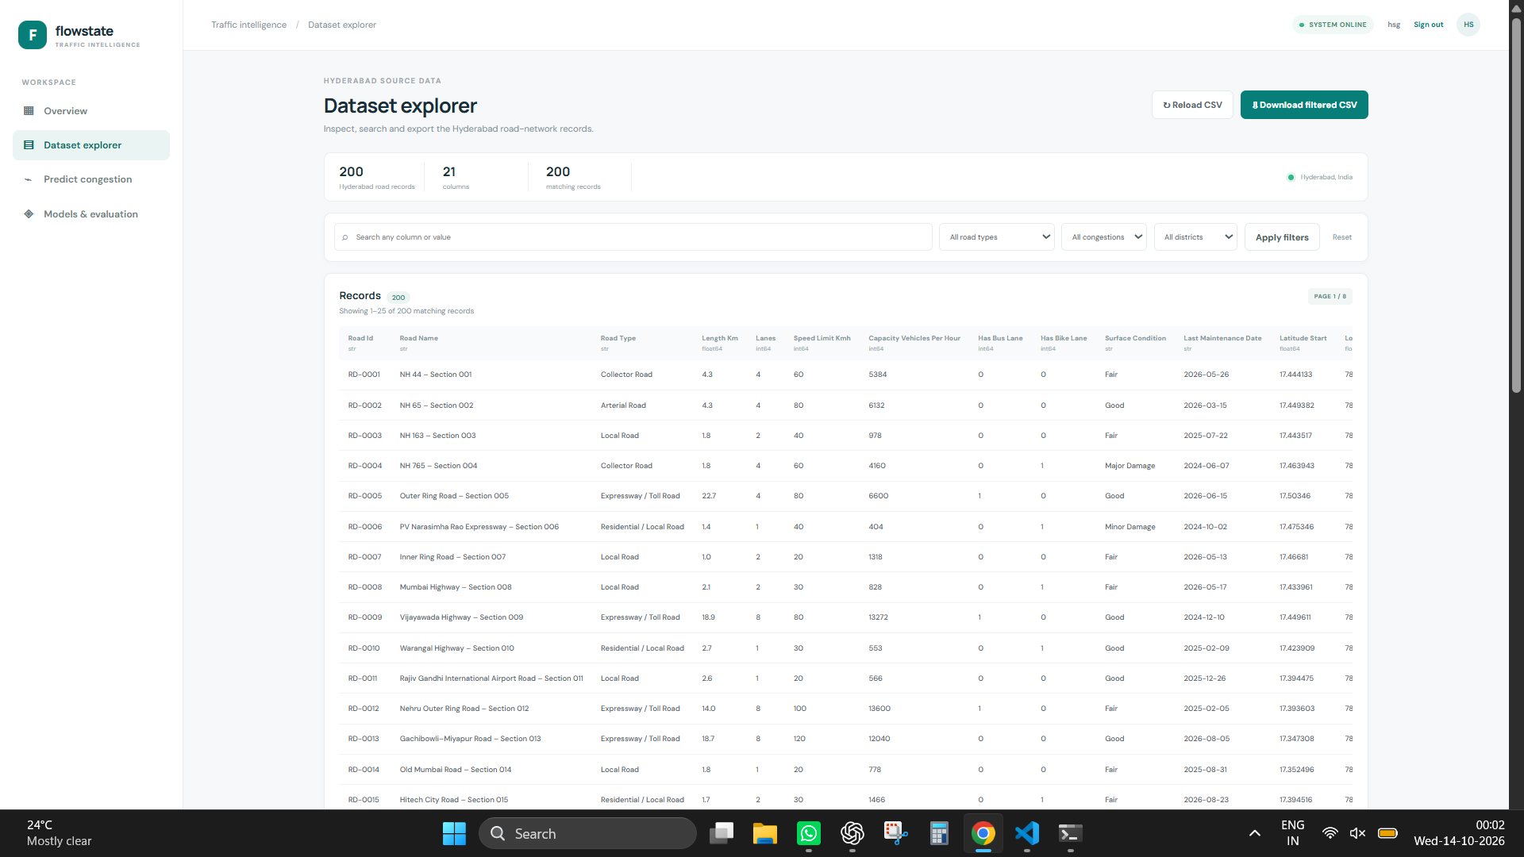
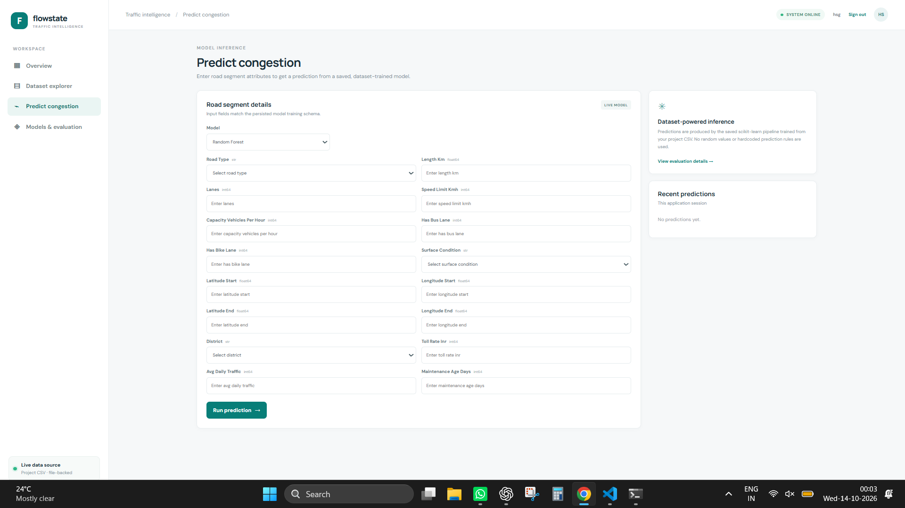
OUTPUT
IMG - 3
IMG - 4
16

Slide 17
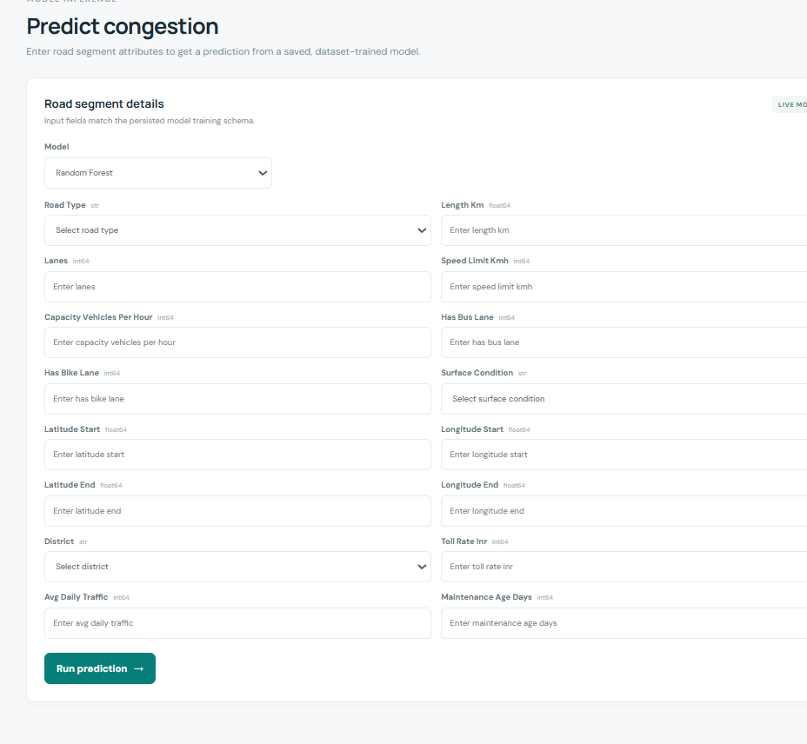
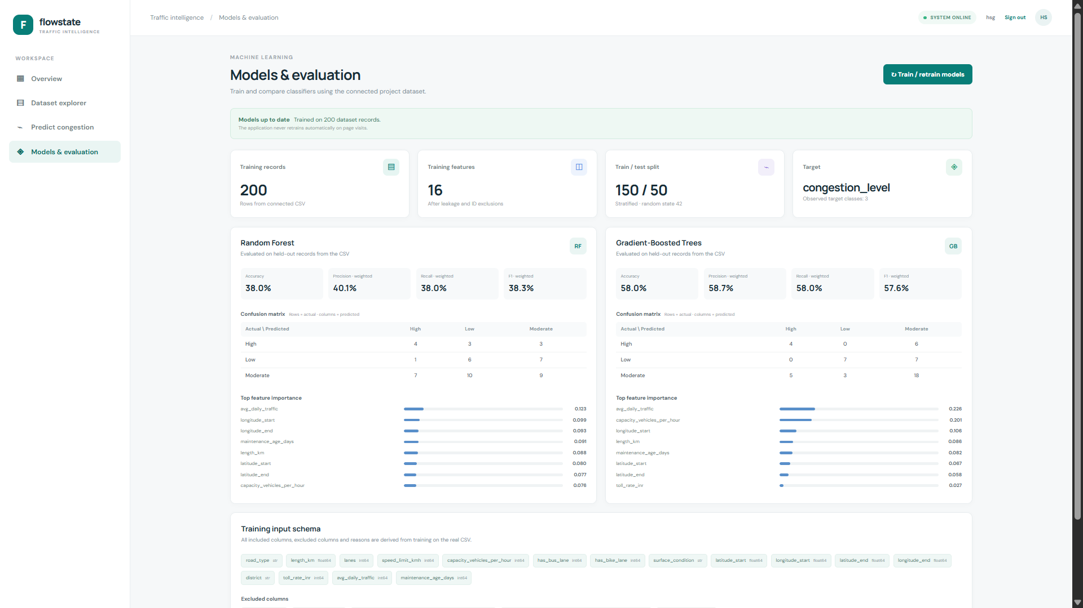
OUTPUT
IMG - 5
IMG - 6
17

Slide 18
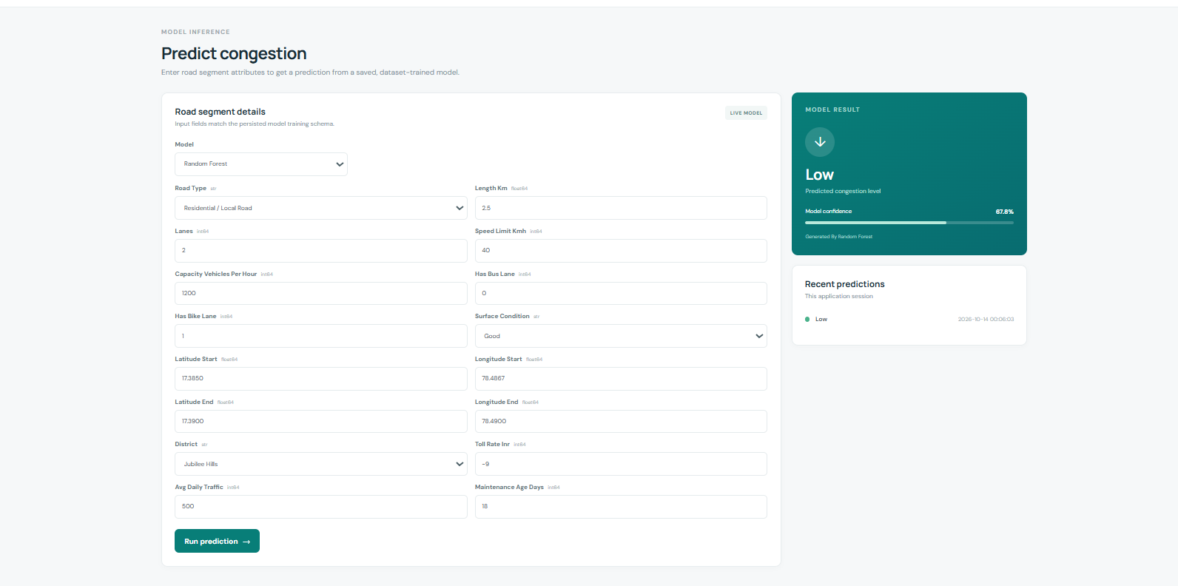
OUTPUT
18

Slide 19
Conclusion & Future Enhancements
CONCLUSION
FUTURE ENHANCEMENTS
The project predicts traffic congestion using Machine Learning.
Traffic, time, weather and road-related features are analysed.
Random Forest and Gradient-Boosted Trees are used for prediction.
The system classifies congestion into Low, Moderate and High levels.
Real-time traffic data integration
Live congestion monitoring
Navigation-system integration
Mobile application
Real-time traffic alerts
19

Slide 20
THANK YOU
Presented by
B. Himavanth Sai Ganesh — 2520030429
G. Shashank — 2520030495

